Slide 1
Building Maintenance Management System
Nijat Shirinov, Fahmin Mahili, Ayatay Kazimli, Latif Askerov

Slide 2
What is Building Maintenance Management System
The reason why we chose it is that there is no single system used by everyone like this in Azerbaijan to manage the maintenance.
Application can be accessible with the smartphones and in the area has network. Owners can set up these processes wherever they are thanks to our application. Owners can make their payments through our application.
The application has an easy-to-use interface for the owners to manage their expenses and maintenance.

Slide 3
Functionalities of System
Creating new maintenance request
Online payment
Tracing expenses
Giving feedback

Slide 4

Architectural Design
We as a team number 6 choose client-server architecture pattern. The client-server architecture is the most suitable architecture style for the Building Management System project due to its scalability, maintainability, and security advantages
The strengths: The weaknesses:
Scalability Dependence on Network
Security Single Point of Failure
Maintainability Cost
Performance
Reliability
A tradeoff was made between the level of reliability and security.

Slide 5
Components and Functions:
Component No. 1: User Management Component
Component state: responsible for maintaining information about the system's users, including their apartment’s number, personal information, and access privileges. It also maintains a log of user activities and system usage statistics.
Component behavior: allows the administrator to create, update, and delete user accounts, as well as assign access privileges and roles to users. It also provides functionality for password management, such as resetting passwords and enforcing password policies.
Component No. 2: Monitoring and Control.
Component state: responsible for maintaining the building maintenance schedule, which includes information such as upcoming maintenance tasks, the status of ongoing maintenance tasks, and the staff assigned to each task.
Component behavior: This component provides the following services to other components:
Allows the manager to view and update the maintenance schedule.
Allows the maintenance staff to view their assigned tasks and mark them as complete once finished.
Notifies the manager and maintenance staff of upcoming and overdue tasks.

Slide 6
Components and Functions:
Component No. 3: Payment Processing
Component State: responsible for maintaining information related to payment processing, including payment amounts, payment methods, and payment statuses.
Component Behavior: The payment processing component provides the functionality to process and authorize payments for services provided by the building management system.
Component No. 4: Notification System
Component state: Maintains a list of notifications to be sent to users, including the content of each notification and the intended recipient(s).
Component behavior: Provides functionality for creating, storing, and sending notifications to users through various channels, such as email, SMS, in-app notifications.

Slide 7
Components and Functions:
Component No. 5: Maintenance Request Form
Component state: Stores the details of a maintenance request, such as the location, type of maintenance required, and priority.
Component behavior: Provides a user-friendly interface for creating and submitting maintenance requests. The form validates user input and allows attaching relevant documents or images to the request. The component also notifies the appropriate staff members of the new maintenance request.
Component No. 6: Feedback Mechanism
Component state: maintains information related to user feedback such as the feedback message, the user who submitted the feedback, and the timestamp of when the feedback was submitted.
Component behavior: provides services to other components by allowing users to submit feedback about the system and stores the feedback in a database. It also sends notifications to the relevant parties (such as the system administrators) when new feedback is submitted, and provides an interface for system administrators to view, manage, and respond to the feedback.

Slide 8
Hardware and Software Specification
 | Standard Client | Standard Web Server | Standard Application Server | Standard Database Server
Operating System | Android, IOS, Windows 11 | Linux | Linux | Linux
Special Software |  | Apache | Java | Oracle
Hardware | 250-GB Disk Drive | 500-GB Disk Drive Quad-core Xeon | 500-GB Disk Drive Six-core Xeon | 1-TB Disk Drive Eight-core Xeon
Network | Always on broad band, preferred Dial-up at 56 Kbps, possible with some performance loss | Dual 100 Mbps Ethernet | Dual 100 Mbps Ethernet | Dual 100 Mbps Ethernet

Slide 9
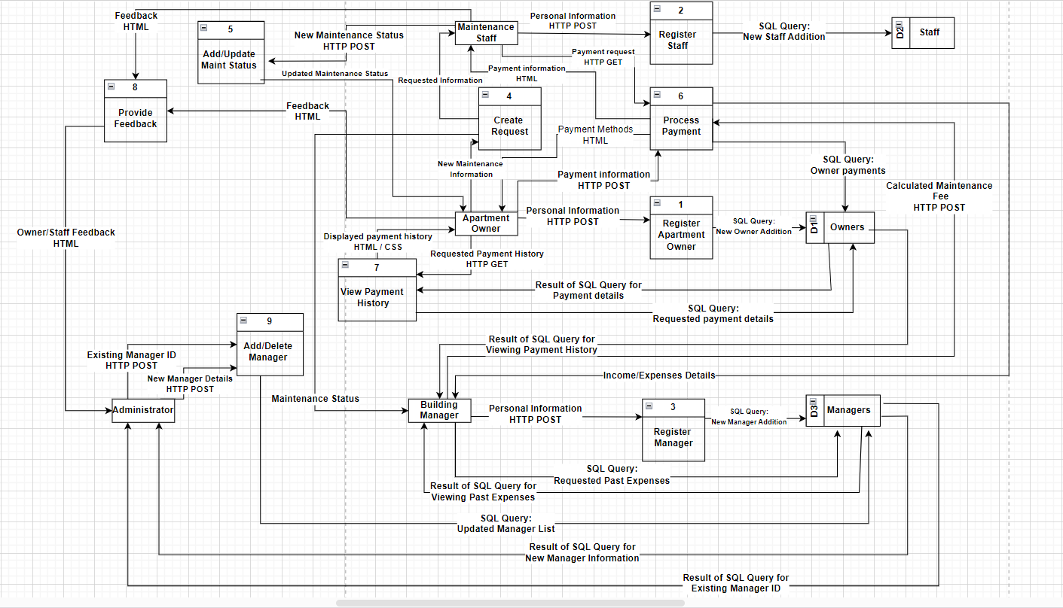
Program Design
Physical DFD

Slide 10
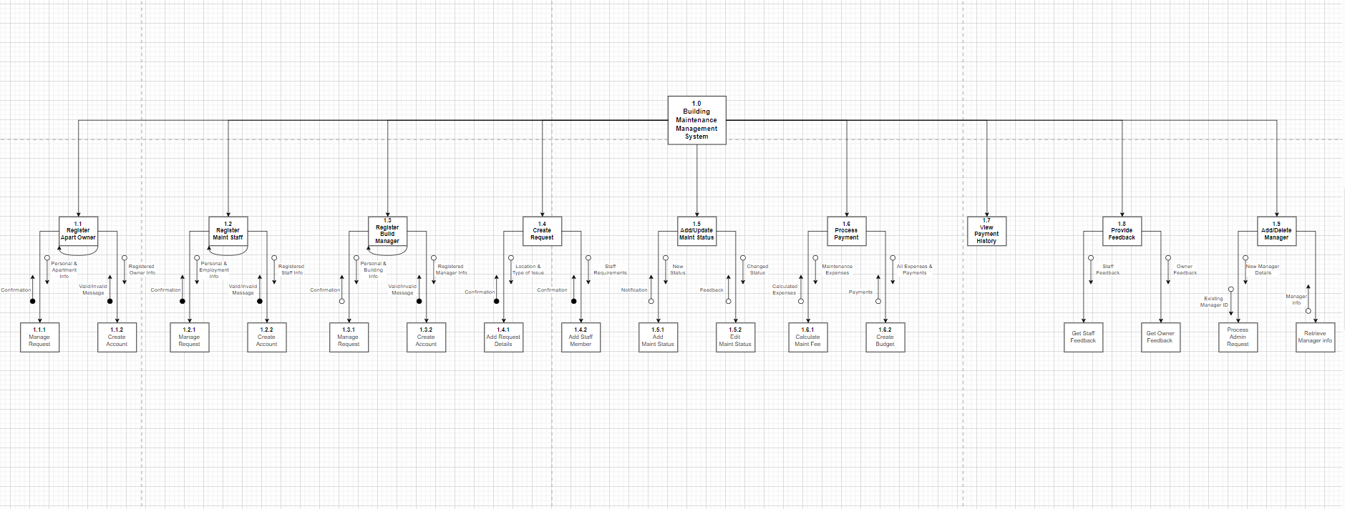
Program Design
Structure Chart

Slide 11
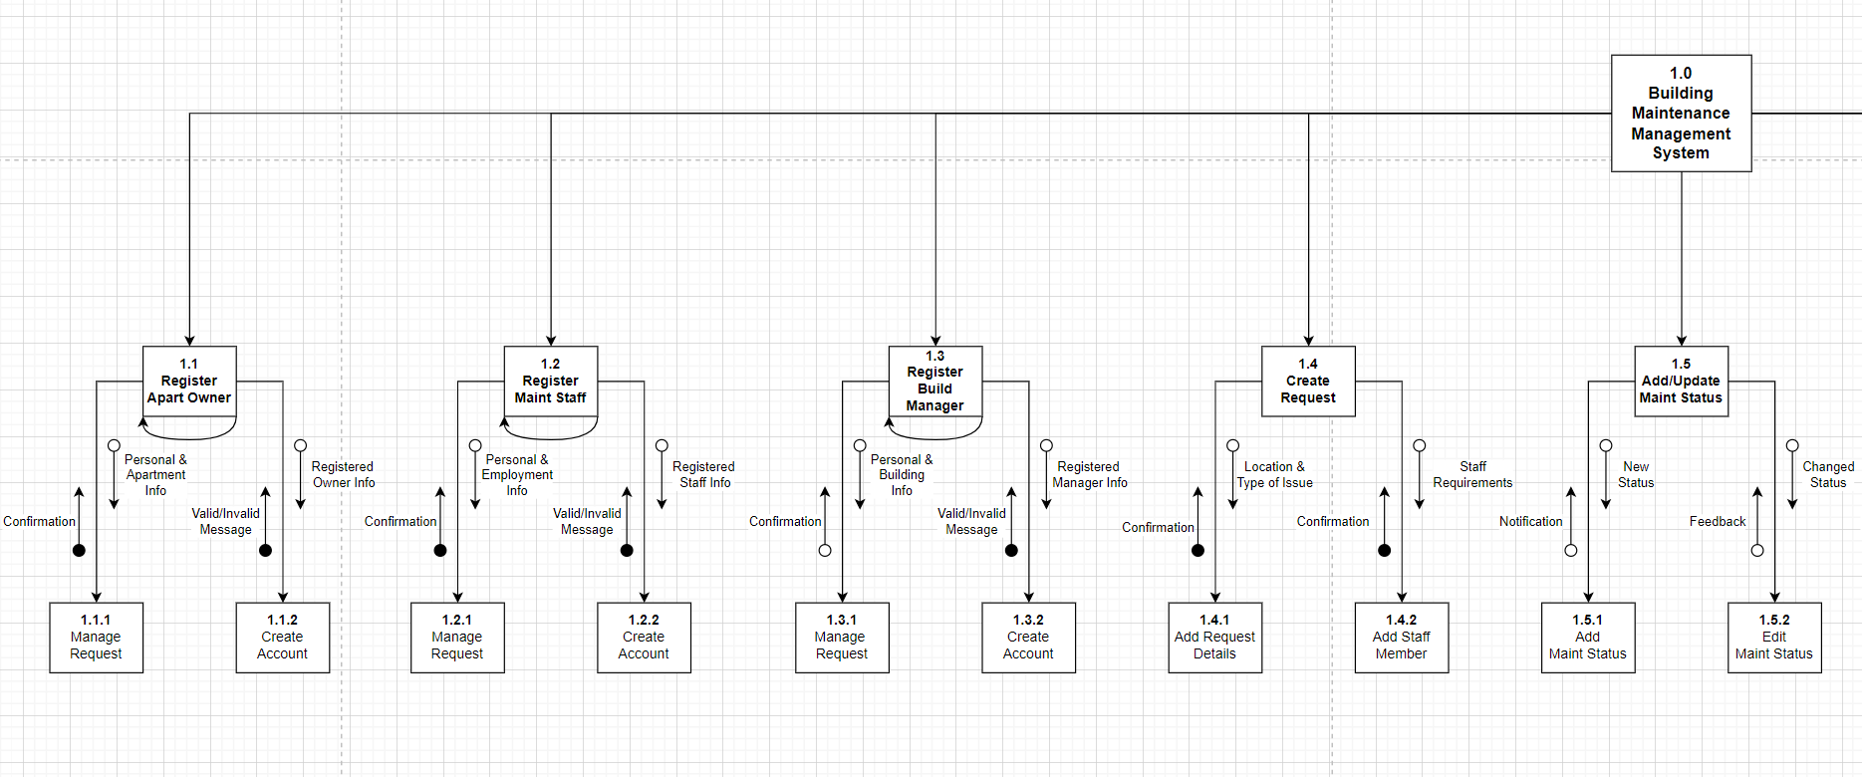
Structure Chart (Part 1)

Slide 12
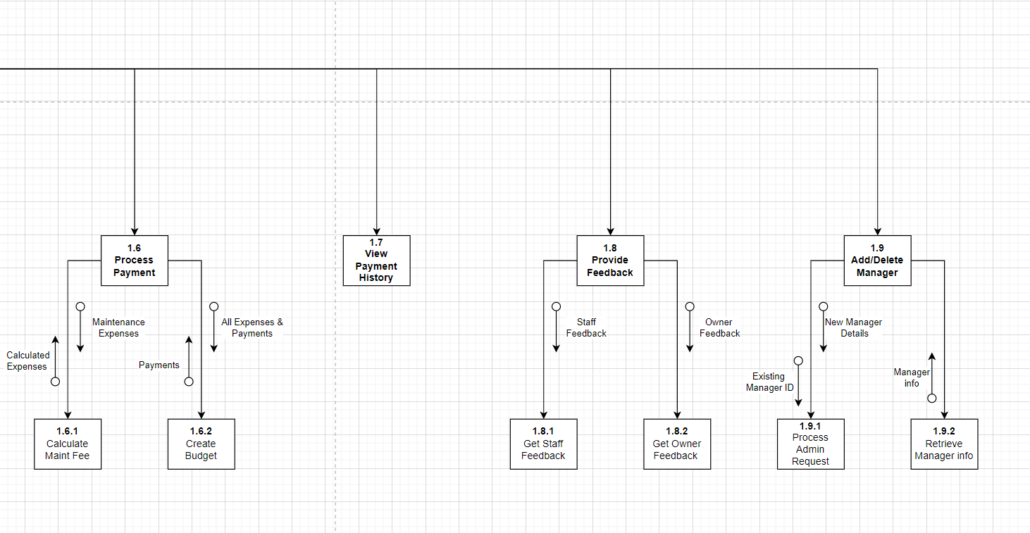
Structure Chart (Part 2)

Slide 13

Relational Database
Advantages:
Data Consistency
Flexibility
Scalability
Refential integrity

Slide 14
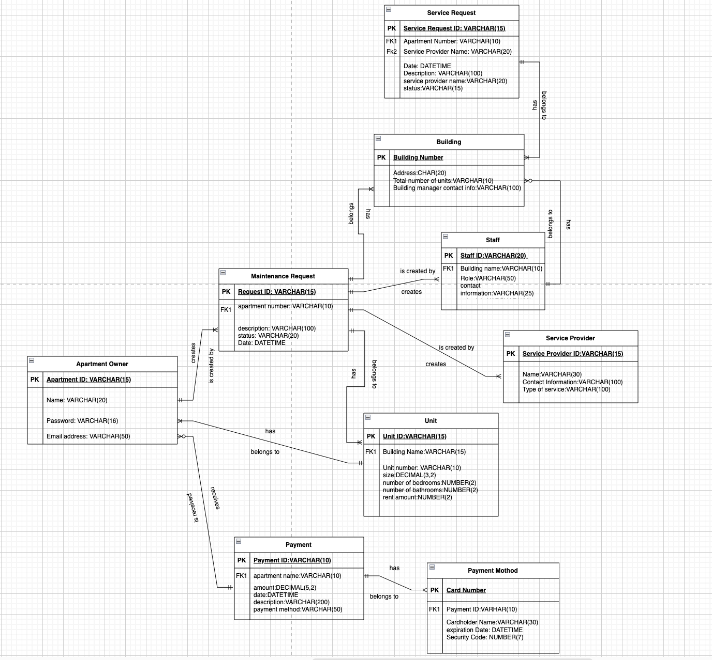
Physical ERD

Slide 15
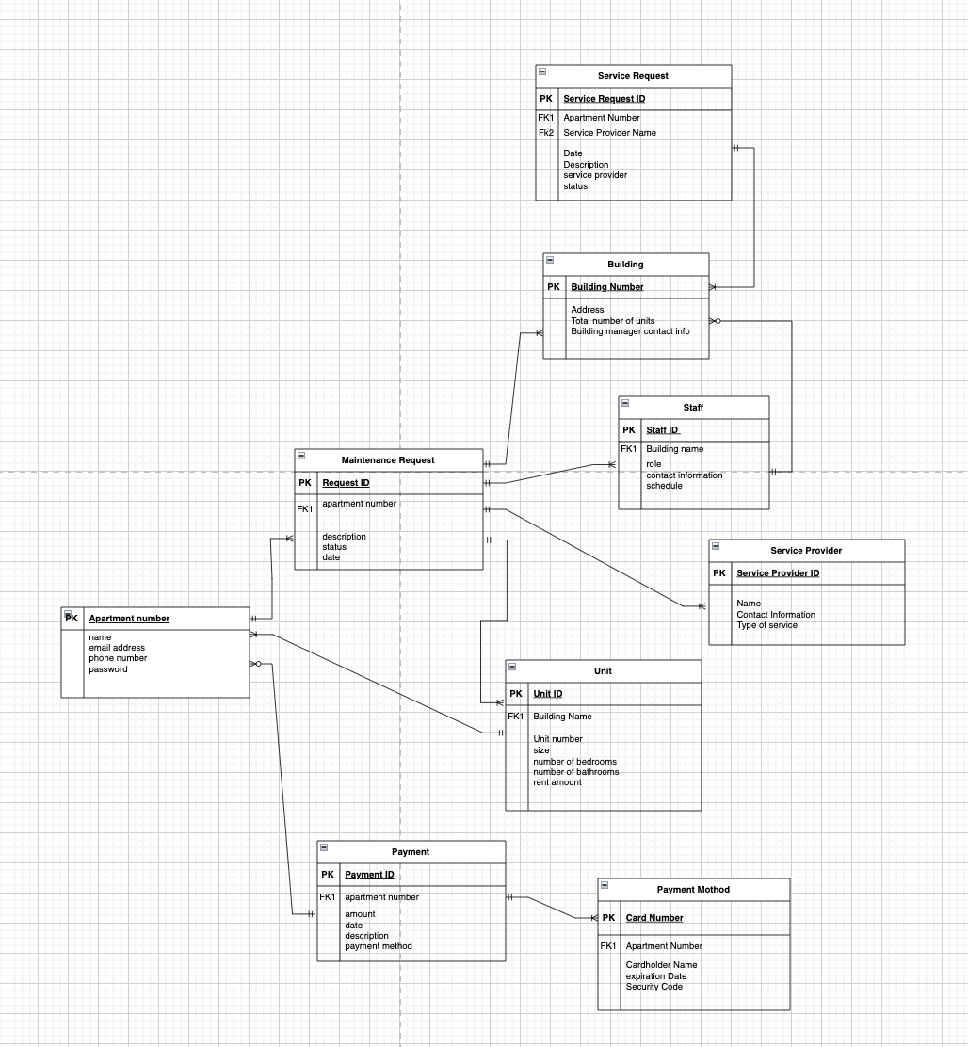
Logical ERD

Slide 16

User Interface Design

Slide 17
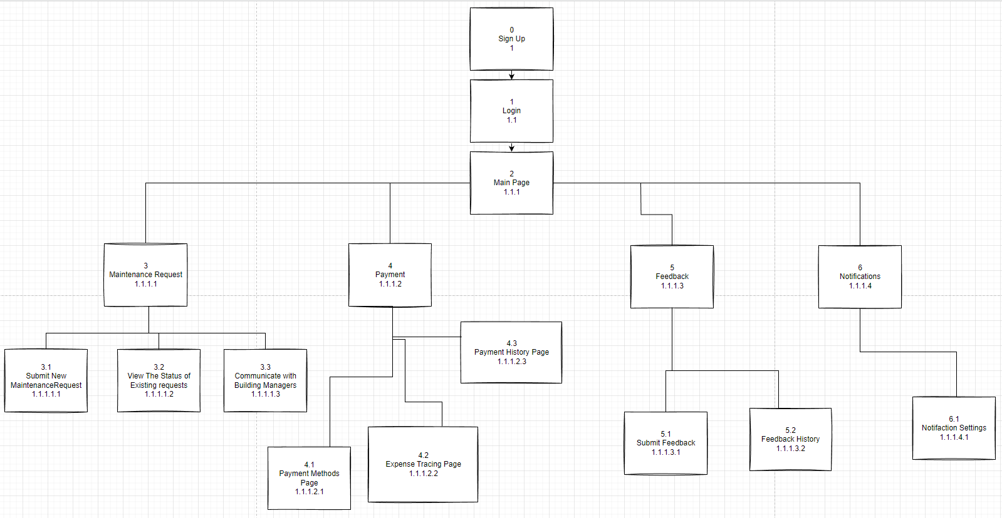
Interface Structure Diagram (ISD)

Slide 18
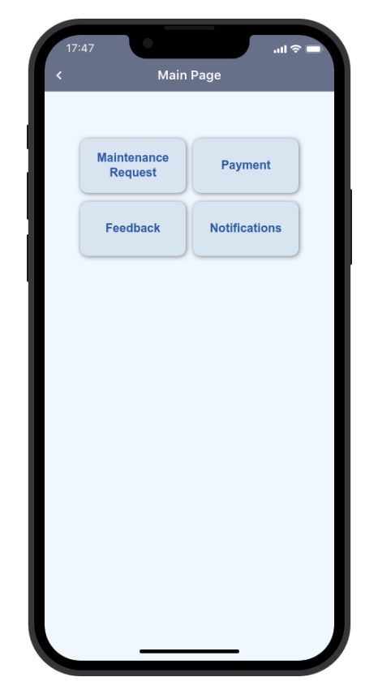
Application

Slide 19


Slide 20

REFERENCES:
https://proto.io/
https://drawio-app.com/
https://www.codingninjas.com/codestudio/library/structure-charts-and-hipo-in-system-analysis
https://www.visual-paradigm.com/guide/data-modeling/what-is-entity-relationship-diagram/
Dennis, A., Wixom, B. H., & Roth, R. M. (2012). System analysis and design. Hoboken, NJ: John Wiley.(Chapter 8)
Dennis, A., Wixom, B. H., & Roth, R. M. (2012). System analysis and design. Hoboken, NJ: John Wiley.(Chapter 9)
Dennis, A., Wixom, B. H., & Roth, R. M. (2012). System analysis and design. Hoboken, NJ: John Wiley.(Chapter 10)
Dennis, A., Wixom, B. H., & Roth, R. M. (2012). System analysis and design. Hoboken, NJ: John Wiley.(Chapter 11)

